Slide 1

ICT-4257: Cryptography and Network Security
for
4th Year 2nd Semester of B.Sc (Honors) in ICT
Lecture File: 01
Mathematics for Cryptography
Prepared by:
Professor K M Akkas Ali
akkas@juniv.edu, akkas_khan@yahoo.com
Institute of Information Technology (IIT)
Jahangirnagar University, Dhaka-1342

Slide 2
Recommended Books
1. | Cryptography and Network Security
 | - by Behrouz A. Forouzan
2. | Cryptography and Network Security
 | - 5th Edition by William Stallings
Slide-2

Slide 3
Lecture File-01:
Mathematics for Cryptography
Topics to be Discussed:
Importance of Math in Network Security
Integer Arithmetic with Binary Operations
Divisibility and Modular Arithmetic
Greatest Common Divisors
Determining Multiplicative Inverse
Solving Linear Diophantine Equations
Matrices
Prime Factorization

Slide 4
Why Mathematics is Needed in Security?
Modern security is heavily based on some areas of mathematics, including number theory, linear algebra, and algebraic structures.
Security algorithms are designed around computational hardness assumptions using mathematical functions and formula, making such algorithms hard to break in practice by any adversary.
A list of mathematical fields used in network security is given below.
Number Theory:
It is used to understand why and how RSA works. Some algorithms use number theory for the difficulty of factoring large numbers as their basis.
Group theory:
Group theory is used to understand why and how El Gamal works.
Probability theory:
It is used in analyzing many kinds of ciphers to better understand what "statistical security" means.
Algebraic structure:
The theory of finite fields is used in multiparty computation.
Linear Algebra:
Lagrange interpolation is used in Shamir's Secret Sharing Scheme. Some linear operations are also used in AES.

Slide 6
What does it mean-?
Z
Z⁺
Z⁻
Z^{Non-Neg}
Z_{n}
Z*_{n}

Slide 7
What do you mean by Binary Operation? Give examples.
List a non-binary operation.
Why Division is not a binary operation?
Is modulus a binary operation? Why?
What are the two inputs and single output used in modulus operation?
What range of integer values the input and output of modulus operation can take?

Slide 8
What are the two kinds of Modular Inverse?
Consider two integers x and y in N modulus. What are the criteria such that x is the additive inverse of y and vice versa?
Which values should be considered in N modulus while determining the additive inverse?
Which integers have additive inverse in N modulus?

Slide 9
What is GCD? What rules are used to determine the GCD of two integers? List an algorithm to determine GCD.
What do you mean by Co-prime or mutually prime? When is integer x a co-prime of integer y?

Slide 10
Consider two integers x and y in N modulus. What are the criteria such that x is the multiplicative inverse of y and vice versa?
Which values should be considered in N modulus while determining the multiplicative inverse?
Which integers have multiplicative inverse in N modulus?

Slide 11
Multiplicative inverse?
Can it be negative?
Does multiplicative inverse of 7 exist in 26 modulus?
What does Z₂₆ and Z*₂₆ mean?

Slide 12
GCD?
Two Fact about GCD?
Euclidean GCD Algorithm?
Determine GCD using Euclidean Algorithm. (How many columns are required, what are the label of each column?)

Slide 13
Extended Euclidean Algorithm?
(How many columns are required, what are the label of each column?)
What will be the values of S1, S2, T1 and T2?
Relationship among the parameters of Extended Euclidean Algorithm
Formula for determine the value of S?
Formula for determine the value of T?

Slide 14
Linear Diophantine equations?
Euler’s Phi (Φ) Function/ Euler’s Totient Function?

Slide 16
Types of Integers
Any integer can fall into three categories.
Integers
Positive Integers
Negative Integers
Non-Negative Integers
e.g., 1, 2, 3 etc
e.g., -1, -2, -3 etc
e.g., 0, 1, 2, etc.

Slide 17
Types of Positive Integers
Any positive integer can fall into three categories.
Positive Integers
Unity
Prime
Composite
It has only one divisor, i.e., itself, e.g., 1
It has only two divisors, 1 and itself, e.g., 2, 3, 13 etc.
It has more than two divisors, e.g., 6 (four divisors (1, 2, 3, 6), 9 (three divisors 1, 3, 9) etc.
Note:
When gcd between two positive integers (say a and b) is 1, [e.g., gcd(a, b) = 1], then we say that a and b are relatively prime or they are coprime.

Slide 18

Set of Integers
In integer arithmetic, we use a set and a few operations.
Though you are familiar with this set and the corresponding operations, but they are reviewed here to create a background for modular arithmetic.
The set of integers, denoted by Z, contains all integral numbers (with no fraction) from negative infinity to positive infinity.
Figure: The set of integers

Slide 19
Set of Integers
Some subset of integers are listed below:
Z⁺ = {1, 2, 3, ……………, +∞}
Or,
Z⁺ = {x ∈ Z | x > 0}
Set of all positive integers, ranging from 1 to +∞
(Set of all natural numbers)
Z⁻ = {-∞, …………, -3, -2, -1}
Set of all negative integers, ranging from -1 to -∞
Z^{Non-Neg} = {0, 1, 2, 3, …….., +∞}
Set of all non-negative integers ranging from 0 to +∞
(Set of whole numbers)

Slide 20
Set of Integers
Some subset of integers are listed below (………):
Z^{Non-Pos} = {-∞, ……, -3, -2, -1, 0}
Set of non-positive integers ranging from 0 to -∞
Z_{n} = {0, 1, 2, 3, ………, n-1}
Set of non-negative integers ranging from 0 to (n-1)
(Set of additive inverse in n modulus)
Z*₁₀ = {1, 3, 7, 9}
Set of multiplicative inverse in 10 modulus
Notes:
The set of all integers: Z
The set of all natural numbers: N
The set of all rational numbers: Q
The set of all real numbers: R
The set of all positive real numbers: R⁺
The set of complex numbers: C

Slide 21
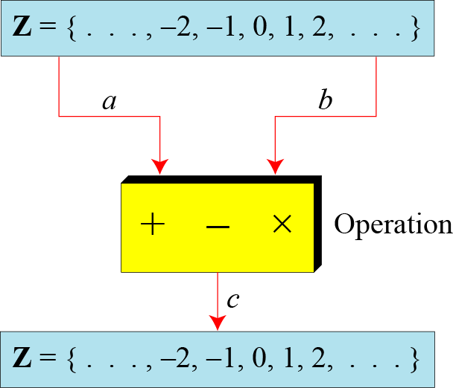
Binary Operations
A binary operation takes two inputs (e.g. a and b) and creates one output (e.g. c).
In cryptography, we are interested in three binary operations applied to the set of integers: addition, subtraction and multiplication.
Figure: Three binary operations for the set of integers

Slide 22
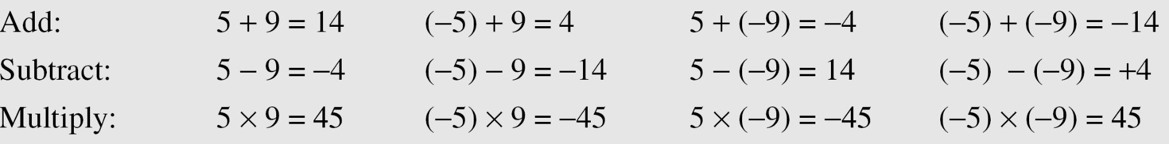
Binary Operations
The following examples shows the results of the three binary operations on two integers.
Because each input can be either positive or negative, we can have four cases for each operation.

Slide 23
Integer Division
In integer arithmetic, if we divide an integer a by a positive integer d, we can get two integers- one is called quotient q and another is called remainder r where 0 ≤ r < d.
The relationship between these four integers is given below:
d is called the divisor
a is called the dividend
q is called the quotient [it is expressed by the notation q = a div d]
r is called the remainder [it is expressed by the notation r = a mod d]
Note:
Division is not a binary operation, because it produces two output instead of one (q and r). We can call it division relation.
a = d × q + r

Slide 24
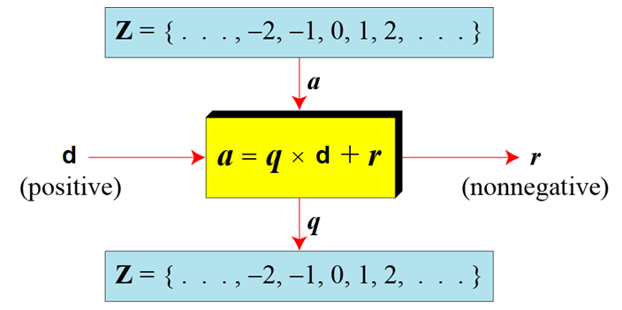
Integer Division
When we use the above division relationship in cryptography, we impose two restrictions:
The divisor be a positive integer (i.e. d>0)
The remainder be a non-negative integer (i.e. r>=0)
Figure below illustrate this fact.
Figure: Division algorithm for integers

Slide 25
Integer Division
Example-1:
Assume that a = 255 and d = 11. We can find q = 23 and r = 2 using the division algorithm a = d × q + r.
a
d
11
255
23
q
253
2
r
Figure: Finding the quotient and the remainder

Slide 26
Integer Division
Example-2:
When we use a computer or a calculator while dividing a by d; r and q are negative when a is negative. How can we apply the restriction that r needs to be positive?
The solution is simple, we decrement the value of q by 1 and we add the value of d to r to make it positive.
d
r
r = d + r
q
q = q-1

Slide 27
Divisibility
If a and b are two integers where a≠0, we can say that a divides b (or, b is divisible by a) if there exists an integer k such that b = ak.
The statement a divides b is written as a | b.
The statement a does not divides b is written as a ∤ b.
When a divides b we say that a is a factor or divisor of b and that b is a multiple of a.
If a | b, then b / a is an integer called quotient.
If a ∤ b, b % a is an integer called remainder.
Example:
4 | 28 because 28 is a multiple of 4, i.e., 28 = 4 × 7
4 ∤ 30, because 30 is not a multiple of 4.

Slide 28
Division Algorithm
When an integer is divided by a positive integer, there is a quotient and a remainder. This is traditionally called the “Division Algorithm,” but is really a theorem.
Division Theorem:
If a is any integer and d is a positive integer, then there exists unique integers q and r, with 0 ≤ r < d, such that a = dq + r.
d is called the divisor
a is called the dividend
q is called the quotient [it is expressed by the notation q = a div d]
r is called the remainder [it is expressed by the notation r = a mod d]
Example:
What are the quotient and remainder when 40 is divided by 3?
q = a div d =40 div 3 =13, r = a mod q =40 mod 3 =1
40 = 3 × 13 + 1

Slide 29
Division Algorithm
Examples-1:
What are the quotient and remainder when 101 is divided by 11?
Solution:
The quotient when 101 is divided by 11 is 9 = 101 div 11, and the remainder is 2 = 101 mod 11.
Examples-2:
What are the quotient and remainder when −11 is divided by 3?
Solution:
The quotient when −11 is divided by 3 is −4 = −11 div 3, and the remainder is 1 = −11 mod 3.

Slide 30
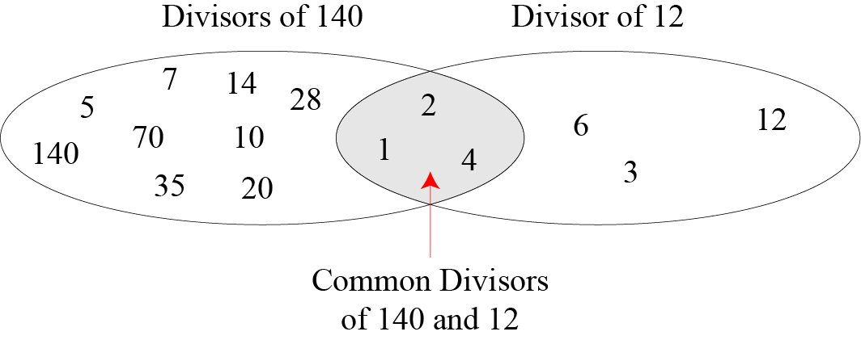
Greatest Common Divisor (GCD)
The greatest common divisor (GCD) of two positive integers is the largest integer that can divide both integers.
GCD is often needed in cryptography.
Two positive integers may have many common divisors, but only one is the greatest of them.
For example, the common divisors of 12 and 140 are: 1, 2, and 4. However, the greatest common divisor is 4.
Greatest common divisor of 140 and 12 is 4.

Slide 31
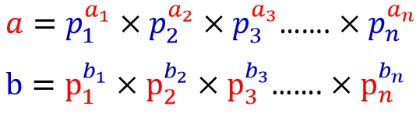
Least Common Multiple (LCM)
The least common multiple (LCM) of two positive integers a and b is the smallest positive integer that is divisible by both a and b.
The least common multiple of a and b is denoted by lcm(a,b).
For example, lcm(4,6)=12; lcm(3,7)=21
We can determine lcm using a variety of methods, e.g., by prime factorizations.
Given a and b be two positive integers. Determine the prime factors of both a and b.
Example:
a = 60 = 2² × 3¹ × 5¹
b = 54 = 2¹ × 3³ × 5⁰
lcm(a,b) = 2² × 3³ × 5¹ = 540

Slide 32
GCD Using Euclidean Algorithm
Finding the GCD of two positive integers by listing all common divisors is not practical when the two integers are large.
More than 2000 years ago, a great mathematician named Euclid developed an algorithm that can find the GCD of two large positive integers.
The Euclidian algorithm is based on the two facts:
Fact 1:
Between the two given integer a and b, if the 2nd integer is zero, then gcd (a, 0) = a. Example: gcd (5, 0) = 5
Fact 2:
When both integer is positive, then gcd (a, b) = gcd (b, r), where r is the remainder of dividing a by b (here the value of first and second integer is changed until the second integer becomes zero.

Slide 33
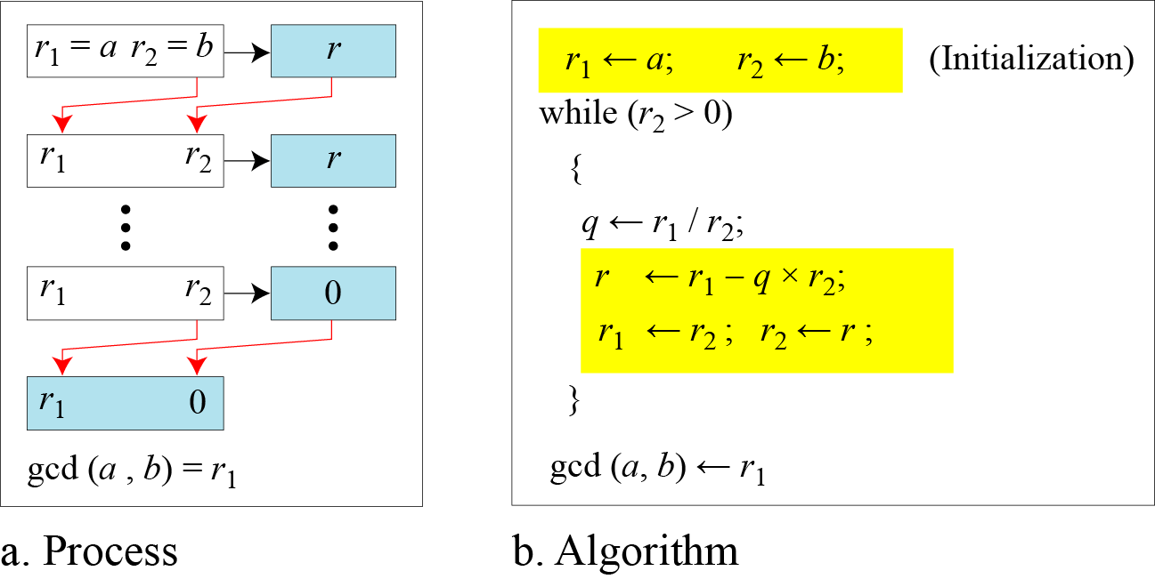
GCD Using Euclidean Algorithm
Figure below shows how we use Fatct-1 and Fact-2 to calculate gcd (a, b) using Euclidean algorithm.
Figure: Euclidean Algorithm
Note:
When gcd (a, b) = 1, we say that a and b are relatively prime or they are coprime.

Slide 34
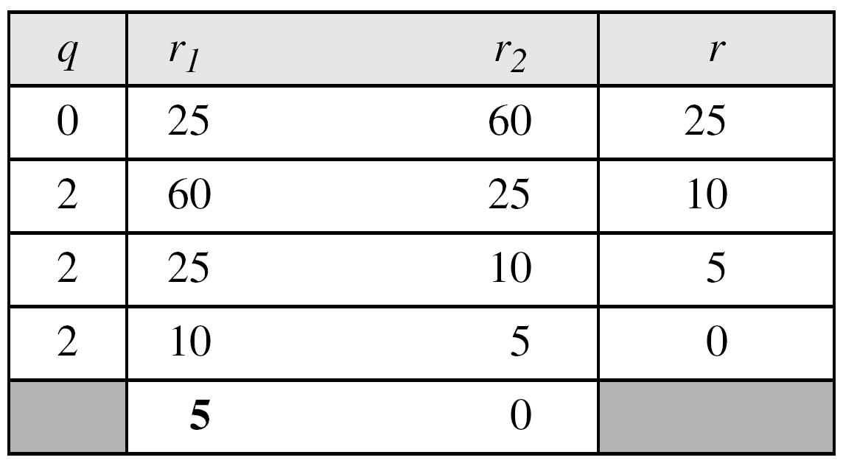
GCD Using Euclidean Algorithm
Example-1
Example-2
Find the greatest common divisor of 2740 and 1760.
Find the greatest common divisor of 25 and 60.
Solution:
Solution:
We have gcd (2740, 1760) = 20.
We have gcd (25, 60) = 5.
Note:
The above example shows that it does not matter if the first number is smaller than the second number. We immediately get our correct ordering gcd(60, 25).

Slide 35

Extended Euclidean Algorithm
Given two integers a and b, we often need to find other two integers, s and t, such that
The extended Euclidean algorithm can calculate the gcd (a, b) and at the same time calculate the value of s and t.
Using extended Euclidean algorithm, we also can find the solutions to the linear Diophantine equations of two variables, an equation of type ax + by = c.

Slide 36
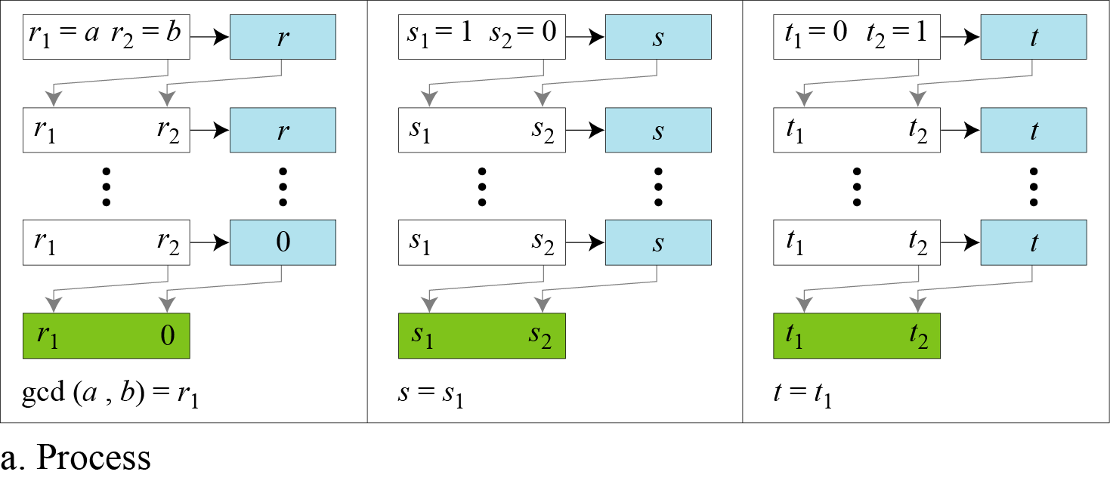
Extended Euclidean Algorithm
Figure: Extended Euclidean algorithm, part a: Process
Note:
Figure shows that the extended Euclidean algorithm uses the same number of steps as the Euclidean algorithm, however, in each step, we use three sets of calculations and exchanges instead of one. Here, three sets of variables are used: r’s, s’s and t’s.

Slide 37
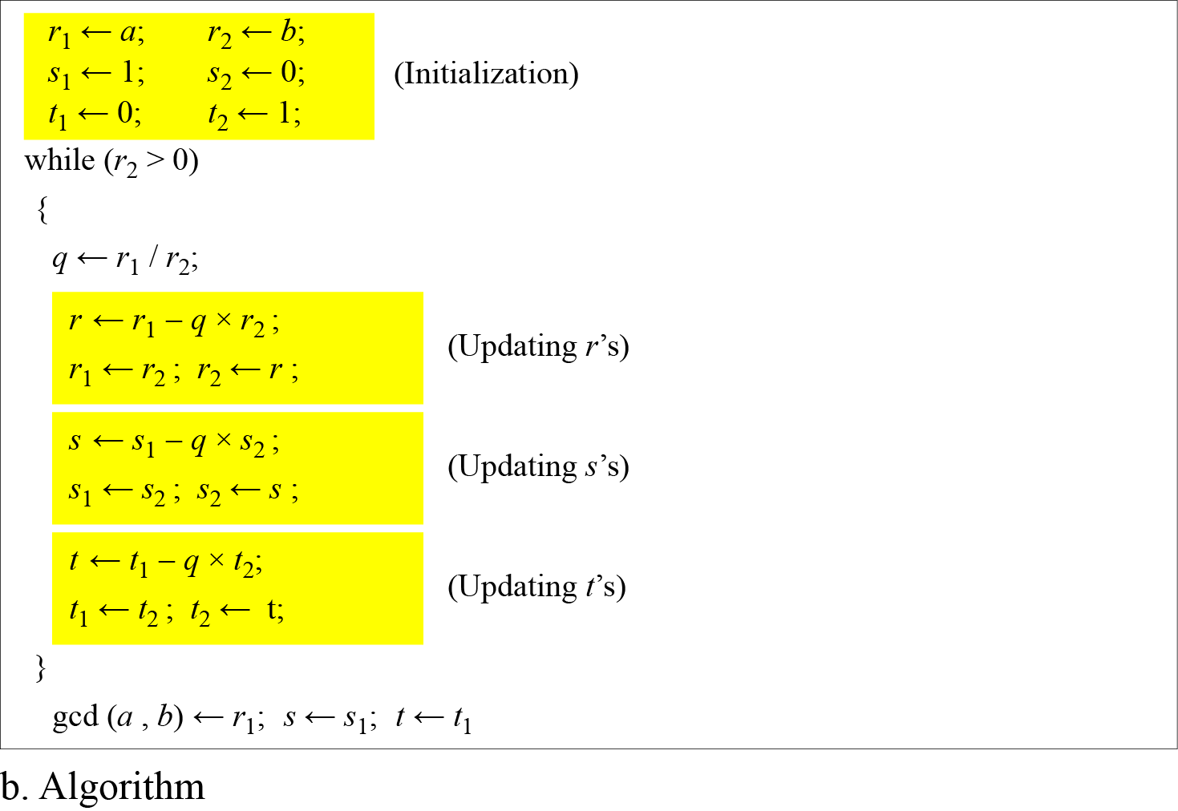
Extended Euclidean Algorithm
Figure: Extended Euclidean algorithm, part b: Algorithm

Slide 38
Extended Euclidean Algorithm
Example-1
Given a = 161 and b = 28, find gcd (a, b) and the values of s and t such that gcd(a, b) = s × a + t × b.
r = r₁ – q × r₂ s = s₁ – q × s₂ t = t₁ – q × t₂
We get gcd (161, 28) = 7, s = −1 and t = 6.
The result can be tested, because (-1) × 161 + 6 × 28 = 7

Slide 39
Extended Euclidean Algorithm
Example-2:
Given a = 17 and b = 0, find gcd (a, b) and the values of s and t.
Solution
We get gcd (17, 0) = 17, s = 1, and t = 0.

Slide 40
Extended Euclidean Algorithm
Example-3:
Given a = 0 and b = 45, find gcd (a, b) and the values of s and t.
Solution
We get gcd (0, 45) = 45, s = 0, and t = 1.

Slide 41
Linear Diophantine Equation by EEA
A linear Diophantine equation of two variables is like: ax + by = c.
Using extended Euclidean algorithm, we can find the solutions to the linear Diophantine equations, that is, we can find the integer values for x and y that satisfy the equation.
Linear Diophantine equation has either no solution or has an infinite number of solutions:
Let d = gcd(a, b)
If dłc, then the equation ax + by = c has no solution.
If d|c, then the equation has an infinite number of solutions.
Among the solutions, one is called particular solution, and the rest is called general solutions.

Slide 42
Linear Diophantine Equation by EEA
Particular solution:
Let ax + by = c is a linear Diophantine equation. Also let, d = gcd(a,b).
If d|c, then a particular solution of the equation can be found using the following steps:
Reduce the equation to a₁x + b₁y = c₁ by dividing both sides of the equation by d.
Solve for s and t in the relation a₁s + b₁t = 1 using extended Euclidean algorithm.
3. The particular solution can be found by the following relations:
x₀ = (c/d)s and y₀ = (c/d)t

Slide 43
Linear Diophantine Equation by EEA
General Solution:
After finding the particular solution, the general solutions of linear Diophantine equation can be found by the following relations:
x = x₀ + k (b/d) and y = y₀ − k(a/d) where k is an integer

Slide 44
Linear Diophantine Equation by EEA
Example:
Using extended Euclidean algorithm, find the particular and general solutions to the following linear Diophantine equation:
21x + 14y = 35.
Solution:
Here, a = 21, b = 14 and c = 35.
d = gcd(a, b) = gcd(21,14) = 7. Since d | c or 7 | 35, the equation has an infinite number of solutions.
Reduce the equation by dividing both sides by 7 to find the equation: 3x + 2y = 5. Here a₁=3, b₁=2 and c₁=5.
Using extended Euclidean algorithm, we find the value of s and t such that 3s + 2t = 1. We have s = 1 and t = -1.
Particular solution: x₀ = (c/d)s and y₀ = (c/d)t
X₀ = (35/7) × 1 = 5 × 1 = 5 and y₀ = (35/7) × (-1) = -5

Slide 45
Linear Diophantine Equation by EEA
Example: (Cont…)
Solution:
General solution:
x = x₀ + k (b/d) and y = y₀ − k(a/d) where k is an integer
X = 5 + k (14/7) = 5 + k × 2
y= -5 – k (21/7) = -5 – k × 3
Therefore, considering the value of k as 0, 1, 2, 3, ….., the solutions to the above equation are (5, -5), (7, -8), (9, -11) …..

Slide 46
Linear Diophantine Equation by EEA
Example:
A very interesting application of linear Diophantine equation in real life is when we want to find different combinations of objects having different values.
For example, imagine we want to cash a $100 check and get some $20 and some $5 bills. We have many choices which can be found by solving the corresponding Diophantine equation 20x + 5y = 100.
Since d = gcd (20, 5) = 5 and 5 | 100, the equation has an infinite number of solutions, but only a few of them are acceptable in this case (only the answers in which both x and y are non-negative integers, because of cash value which can not be negative).
The general solutions with x and y nonnegative are
(0, 20), (1, 16), (2, 12), (3, 8), (4, 4), (5, 0).

Slide 47
Congruence Relation
Consider the result of 2 mod 10 = 2, 12 mod 10 = 2, 22 mod 10 = 2, 32 mod 10 = 2 and so on.
In modular arithmetic, integers like 2, 12, 22 and 32 are called congruent mod 10.
Two integers a and b are congruent modulo a positive integer m if and only if they have the same remainder r when divided by m, i.e., when a mod m = r and b mod m = r.
More technically, if a and b are integers and m is a positive integer, then a is congruent to b modulo m if m divides a – b.
The symbol ≡ is called the congruence operator.
The notation a ≡ b (mod m) says that a is congruent to b modulo m.
We say that a ≡ b (mod m) is a congruence and that m is its modulus.
If a is not congruent to b modulo m, we write a≢b (mod m)

Slide 48
Congruence Relation
Example:
7 and 13 are congruent modulo 3, i.e., 7 ≡ 13 (mod 3).
24 and 14 are not congruent modulo 6, i.e., 24 ≢ 14 (mod 6).

Slide 49
Application of Congruence
Congruences have many applications in cryptography, e.g., shift ciphers
Shift cipher with key k encrypts message by shifting each letter by k letters in alphabet (if past Z, then wrap around)
What is encryption of ”KILL HIM” with shift cipher of key 3?

Slide 50
Modular Arithmetic
Given any positive integer n and any nonnegative integer a, if we divide a by n, we get an integer quotient q and an integer remainder r such that a = q × n + r.
This division relation has two inputs (a and n) and two outputs (q and r).
In modular arithmetic, we are interested in only one of the outputs, the remainder r. In other words, we want to know what is the value of r when we divide a by n.
This implies that, using modular arithmetic, we can change the division relation into a binary operator (called modulo operator) with two inputs a and n and one output r.
The modulo operator is shown as mod. The second input (n) is called the modulus. The output r is called the residue.
Several important cryptosystems make use of modular arithmetic.

Slide 51
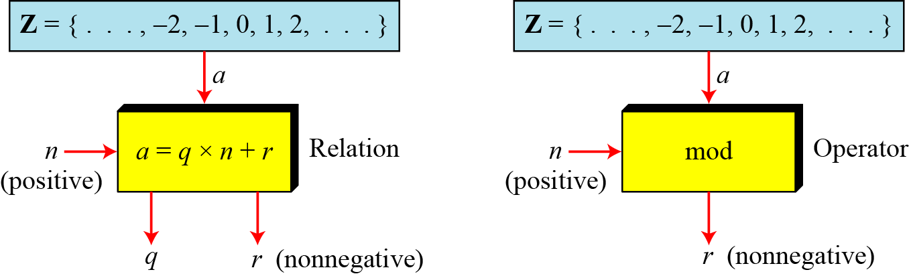
Modular Arithmetic
Figure below shows the division relation compared with the modulo operator.
Figure: Division relation Vs. modulo operator
In the figure we see that the modulo operator (mod) takes an integer (a) from the set of integers (Z) and a positive modulus (n). The operator creates a non-negative residue (r) where 0 <= r <= n-1. We can say that:
a mod n = r

Slide 52
Modular Arithmetic
There are three cases for calculating modulus:
Case-1:
When both of a and n is positive integer where a<n:
In this case, we add as many multiples of n with a as necessary to get a greater than n. Then divide a by n to get the remainder r. The result will be in the range 0 to n-1. For example, 2 mod 7 = 9 mod 7 = 2.
Case-2:
When both of a and n is positive integer with a>=n:
In this case, just divide a by n to get the remainder r. The result will be in the range 0 to n-1. For example, 9 mod 7 = 2.
Case-3:
When a is negative and n is positive integer:
In this case, we add as many multiples of n with a as necessary to get a positive and greater than n. Then divide a by n to get the remainder r. The result will be in the range 0 to n-1. The process is known as modulo reduction. For example, -12 mod 7 = -5 mod 7 = 2 mod 7 = 9 mod 7

Slide 53
Modular Arithmetic
Example:
Find the result of the following operations:
a. 27 mod 5 b. 36 mod 12
c. −18 mod 14 d. −7 mod 10
Solution
Dividing 27 by 5 results in r = 2. Therefore 27 mod 5 = 2
Dividing 36 by 12 results in r = 0. Therefore 36 mod 12 = 0
c. Dividing −18 by 14 results in r = −4. After adding the modulus (14) with the result to make it non-negative, we have r = -4 + 14 = 10. Therefore -18 mod 14 = 10
d. Dividing −7 by 10 results in r = −7. After adding the modulus (10) with the result to make it non-negative, we have r = -7 + 10 = 3. Therefore –7 mod 10 = 3

Slide 54
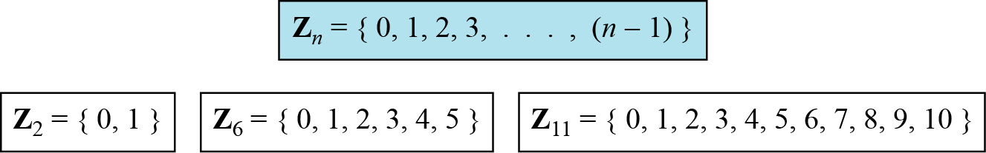
Modular Arithmetic- Set of Residues
The result of a mod n is always an integer between 0 and n-1.
Therefore, the modulo operation creates a set, which in modular arithmetic is referred to as the set of least residues modulo n, or Z_{n}.
Figure below shows the set of residues Z_{n} and three instances of the set of residues Z₂, Z₆, Z₁₁.
Figure: Some Z_{n} sets

Slide 55
Modular Arithmetic- Inverse Operation
In cryptography, we often need to find the inverse of a number relative to an operation. For example, if the sender uses an integer as the encryption key, the receiver uses the inverse of that integer as the decryption key.
We are normally looking for two kinds of inverse:
Additive Inverse
If the operation is addition, then additive inverse is used.
The set of additive inverse is expressed as Z_{n}
Multiplicative Inverse
If the operation is multiplication, we are normally looking for multiplicative inverse.
The set of multiplicative inverse is expressed as Z_{n}*.

Slide 56

Modular Arithmetic- Additive Inverse
In Z_{n}, two numbers a and b are additive inverses of each other if
In modular arithmetic, each integer has an additive inverse.
The sum of an integer and its additive inverse is congruent to 0 modulo n.
Example:
Find all additive inverse pairs in Z₁₀.
Solution:
The six pairs of additive inverses are
(0, 0), (1, 9), (2, 8), (3, 7), (4, 6), and (5, 5).

Slide 57

Modular Arithmetic- Multiplicative Inverse
In Z_{n}, two numbers a and b are the multiplicative inverse of each other if
In modular arithmetic, an integer may or may not have a multiplicative inverse.
If an integer and the given modulus are co-prime (or if the GCD between the integer and modulus is 1), then multiplicative inverse of the integer exists in the given modulus.
Example-1:
Find the multiplicative inverse of 8 in Z₁₀.
Solution
There is no multiplicative inverse because gcd(10,8) = 2 ≠ 1.
In other words, we cannot find any number between 0 and 9 such that when multiplied by 8, the result is congruent to 1.

Slide 58
Modular Arithmetic- Multiplicative Inverse
Example-2:
Find all multiplicative inverses in Z₁₀.
Solution
There are only three pairs: (1, 1), (3, 7) and (9, 9).
The integers 0, 2, 4, 5, 6, and 8 do not have a multiplicative inverse.
Example:
Find all multiplicative inverse pairs in Z₁₁.
Solution
We have seven pairs: (1, 1), (2, 6), (3, 4), (5, 9), (7, 8), (9, 5), and (10, 10).

Slide 59
Multiplicative Inverse Using EEA
The extended Euclidean algorithm finds the multiplicative inverses of b in Z_{n} when n and b are given and gcd (n, b) = 1.
The multiplicative inverse of b is the value of t after being mapped to Zn.

Slide 60
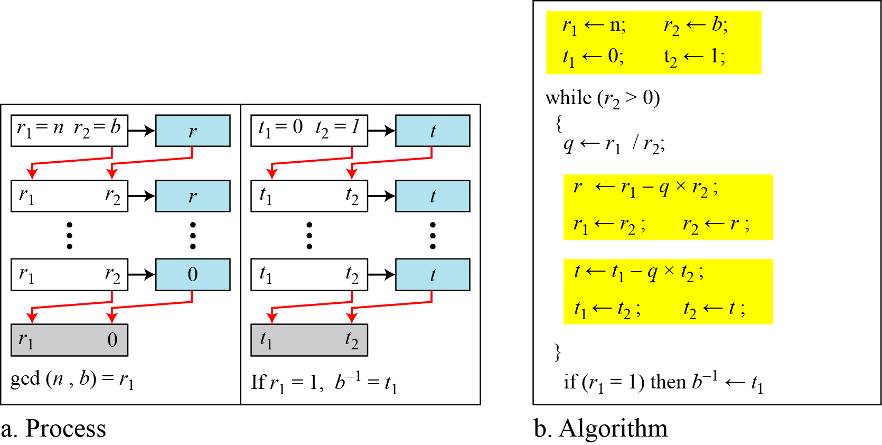
Multiplicative Inverse Using EEA
Multiplicative inverse of an integer in a particular modulus can be determined using extended Euclidean algorithm.
The process and algorithm are given below:

Slide 61
Multiplicative Inverse Using EEA
Example:
Find the multiplicative inverse of 11 in Z₂₆.
Solution:
Since, gcd (26, 11) = 1; the multiplicative inverse of 11 in 26 modulus is -7 or 19 (Since, multiplicative inverse can not be negative).

Slide 62
Multiplicative Inverse Using EEA
Example:
Find the multiplicative inverse of 23 in Z₁₀₀.
Solution:
The gcd (100, 23) is 1; the multiplicative inverse of 23 in 100 modulus is -13 or 87.

Slide 63
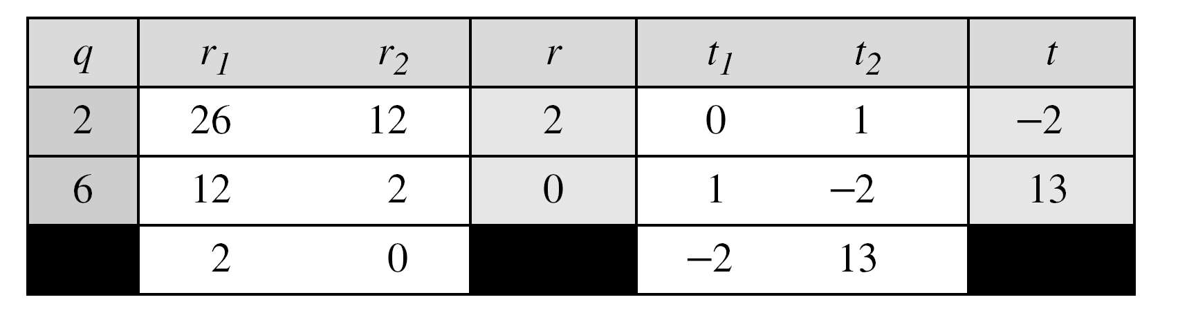
Multiplicative Inverse Using EEA
Example:
Find the inverse of 12 in Z₂₆.
Solution
The gcd (26, 12) is 2; the inverse does not exist.

Slide 64
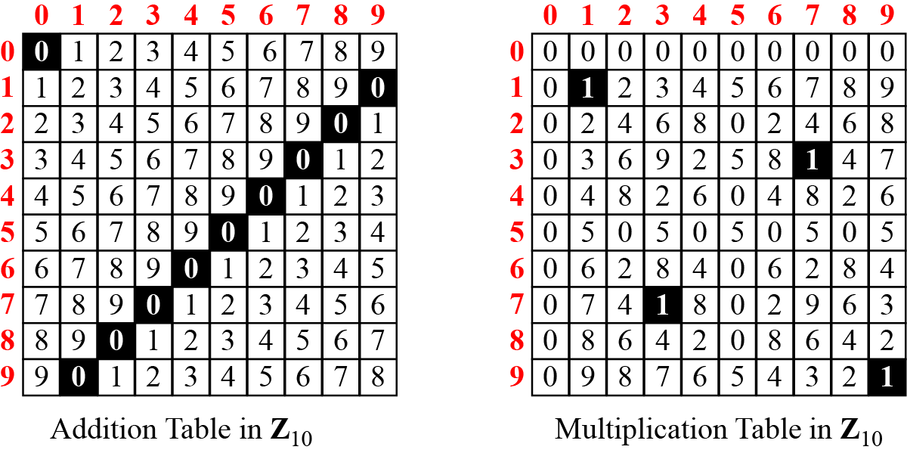
Modular Inverse- Addition & Multiplication Tables
We can easily find out the additive and multiplicative inverse of an integer in Z_{n} using addition and multiplication table respectively.
Figure below shows the addition and multiplication table for Z₁₀.
z = (x + y) mod 10
z = (x * y) mod 10
x
x
y
y
Figure: Addition and multiplication table for Z₁₀

Slide 65
Modular Inverse- Addition & Multiplication Tables
Figure below shows the multiplication table for Z₁₃.
x
z = (x * y) mod 13
y
 | 0 | 1 | 2 | 3 | 4 | 5 | 6 | 7 | 8 | 9 | 10 | 11 | 12
0 | 0 | 0 | 0 | 0 | 0 | 0 | 0 | 0 | 0 | 0 | 0 | 0 | 0
1 | 0 | 1 | 2 | 3 | 4 | 5 | 6 | 7 | 8 | 9 | 10 | 11 | 12
2 | 0 | 2 | 4 | 6 | 8 | 10 | 12 | 1 | 3 | 5 | 7 | 9 | 11
3 | 0 | 3 | 6 | 9 | 12 | 2 | 5 | 8 | 11 | 1 | 4 | 7 | 10
4 | 0 | 4 | 8 | 12 | 3 | 7 | 11 | 2 | 6 | 10 | 1 | 5 | 9
5 | 0 | 5 | 10 | 2 | 7 | 12 | 4 | 9 | 1 | 6 | 11 | 3 | 8
6 | 0 | 6 | 12 | 5 | 11 | 4 | 10 | 3 | 9 | 2 | 8 | 1 | 7
7 | 0 | 7 | 1 | 8 | 2 | 9 | 3 | 10 | 4 | 11 | 5 | 12 | 6
8 | 0 | 8 | 3 | 11 | 6 | 1 | 9 | 4 | 12 | 7 | 2 | 10 | 5
9 | 0 | 9 | 5 | 1 | 10 | 6 | 2 | 11 | 7 | 3 | 12 | 8 | 4
10 | 0 | 10 | 7 | 4 | 1 | 11 | 8 | 5 | 2 | 12 | 9 | 6 | 3
11 | 0 | 11 | 9 | 7 | 5 | 3 | 1 | 12 | 10 | 8 | 6 | 4 | 2
12 | 0 | 12 | 11 | 10 | 9 | 8 | 7 | 6 | 5 | 4 | 3 | 2 | 1
Figure: Addition and multiplication table for Z₁₃

Slide 66
Set of Additive and Multiplicative Inverse
Set of Additive Inverse Z_{n}
Set of Multiplicative Inverse Z_{n*}
Z_{n} is a set that contains all integers from 0 to n-1.
In Z_{n} , each integer has an additive inverse.
Therefore Z_{n} can also be used as the set of additive inverse. Each member of Z_{n} has an additive inverse.
In Z_{n}, an integer may or may not have a multiplicative inverse. Only some members of Z_{n} have a multiplicative inverse.
Therefore, for multiplication operation, we need another set Z_{n*} which is a subset of Z_{n} that includes only those integers from Z_{n} that have a unique multiplicative inverse.

Slide 67
Set of Additive and Multiplicative Inverse
Notes:
Each member of Z_{n} has an additive inverse, but only some members of Z_{n} have a multiplicative inverse.
On the other hand, Each member of Z_{n*} has a multiplicative inverse, but all members of Z_{n*} have an additive inverse.
Z_{n} and Z_{n*} can be made from addition and multiplication tables respectively.
We need to use Z_{n} when additive inverses are needed; we need to use Z_{n*} when multiplicative inverses are needed.

Slide 68
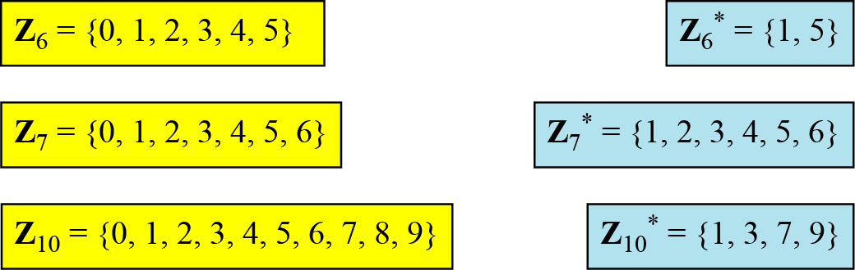
Set of Additive and Multiplicative Inverse
Some Instances of Z_{n} and Z_{n*}
Figure: Some Z_{n} and Z_{n}* sets

Slide 69
Set of Additive and Multiplicative Inverse
Two More Sets: Z_{p} and Z_{p*} :
Cryptography often uses two more sets: Z_{p} and Z_{p}*. The modulus in these two sets is a prime number.
The set Z_{p} is the same as Z_{n} except that n is a prime.
Z_{p} contains all integers from 0 to p-1.
Each member in Z_{p} has an additive inverse; each member except 0 has a multiplicative inverse.
The set Z_{p*} is the same as Z_{n*} except that n is a prime.
Z_{p*} contains all integers from 1 to p-1.
Each member in Z_{p*} has an additive and a multiplicative inverse;
Figure: The set Z_{p} and Z_{p*} when p=13

Slide 70
Euler’s Phi (Φ) Function
Euler’s phi-function, Φ(n) which is sometimes called the
Euler’s Totient function plays a very important role in cryptography.
Finding the number of elements in Z_{n} :
Z_{n} is a set that contains all integers from 0 to n-1.
Finding the number of elements in Z_{n*} :
We can determine the number of elements in the set Z_{n}* using Euler’s Phi-Function (sometimes called the Euler’s Totient function), Φ(n) that finds the number of integers that are both smaller than n and relatively prime to n.
The following rules helps to find the value of Φ(n):

Slide 71
Euler’s Phi Function
Example-1:
Find the number of elements in Z₁₃* using Euler’s Phi-Function.
Solution:
Since 13 is a prime, so according to the second rule,
Φ(13)=(13-1)=12
Example-2:
Find the number of elements in Z₁₀* using Euler’s Phi-Function.
Solution:
Since 10 is not a prime, so according to the third rule,
Φ(10)= Φ(5x2)= Φ(2) x Φ(5)=(2-1) x (5-1)= 1 x 4 =4
Example-3:
Find the number of elements in Z₄₉* using Euler’s Phi-Function.
Solution:
Since 49 is not a prime and it can not be factored as the product of two relatively primes, so according to the fourth rule,
Φ(49)= Φ(7²)= 7² – 7²⁻¹= 49 – 7 = 42
Interesting point: If n > 2, the value of f(n) is even.

Slide 72
Matrices
In cryptography we need to handle matrices.
Although this topic belongs to a special branch of algebra called linear algebra, the following brief review of matrices is necessary preparation for the study of cryptography.

Slide 73
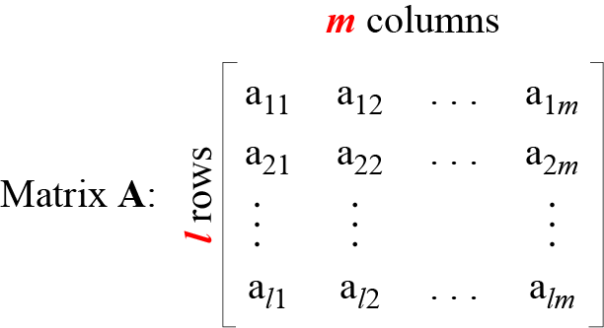
Matrices
A matrix is a rectangular array of l × m elements, in which l is the number of rows and m is the number of columns.
It is normally denoted with a boldface uppercase letter such as A.
The element a_{ij} is located in the ith row and jth column.
Figure: A matrix of size l × m

Slide 74
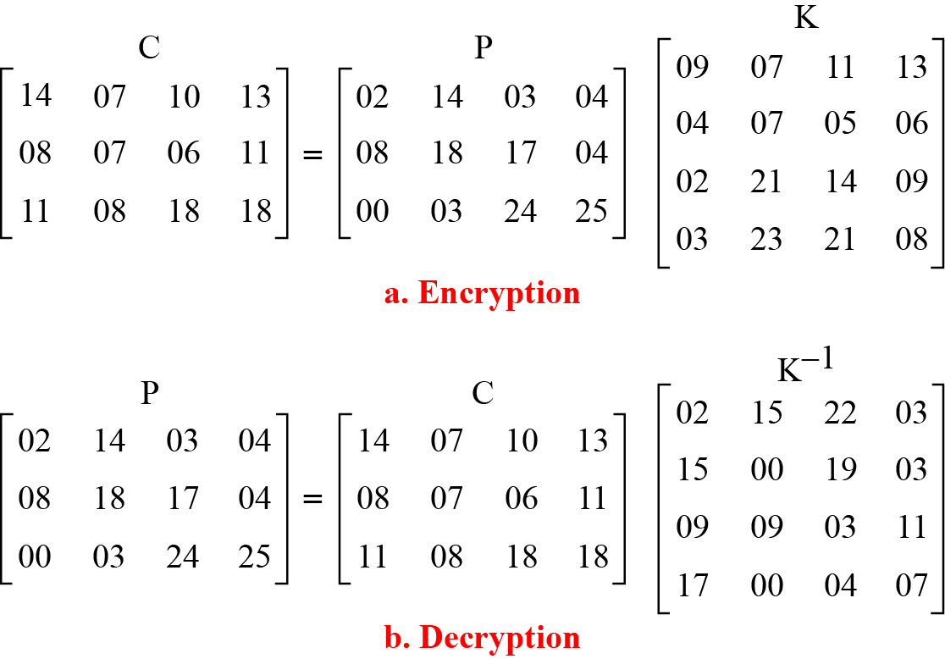
Hill Cipher
Example:
Encrypt the message “code is ready” using Hill cipher.
Solution:
There are 11 characters in the plaintext message.
For dividing it into equal-size blocks (here, 3 blocks with 4 characters per block), add an extra bogus character “z” to the last block, and then remove the spaces.
Thus, the plaintext characters can be represented by a 3 × 4 matrix P.
Hence, the key will be a 4 x 4 square matrix K.
The ciphertext is obtained from ciphertext matrix C as “OHKNIHGKLISS”.
Decryption is done using the inverse of the key matrix.
Example: Hill Cipher

Slide 75
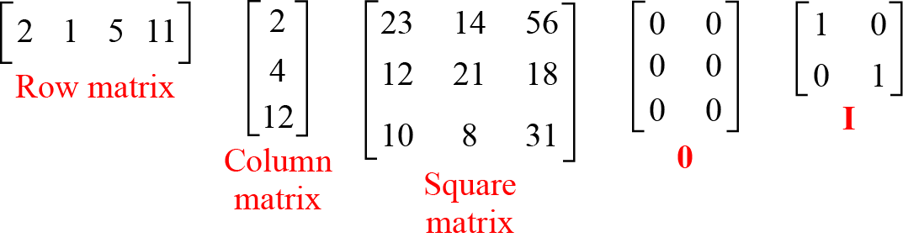
Matrices
Example of Matrices:
Row matrix:
If a matrix has only one row (l), then it is called a row matrix.
Column matrix:
If a matrix has only one column (m), then it is called a column matrix.

Slide 76
Matrices
Example of Matrices:
Square Matrix:
If a matrix has same number of rows and columns (l = m), then it is called a square matrix. In a square matrix, the elements a₁₁, a₂₂, ….. ,a_{mm} make the main diagonal.
Additive Identity Matrix:
It is a kind of matrix with all rows and columns set to 0’s. It is denoted as O.
Identity Matrix:
It is a kind of square matrix with 1’s on the main diagonal and 0’s elsewhere. It is denoted as I.

Slide 77
Operations and Relations in Matrices
In linear algebra, one relation (equality) and four operations (addition, subtraction, multiplication and scalar multiplication) are defined for matrices.
Equality:
Two matrices are equal if they have the same number of rows and columns and the corresponding elements are equal.
In other words, A = B if we have aij = B_{ij} for all i’s and j’s.

Slide 78
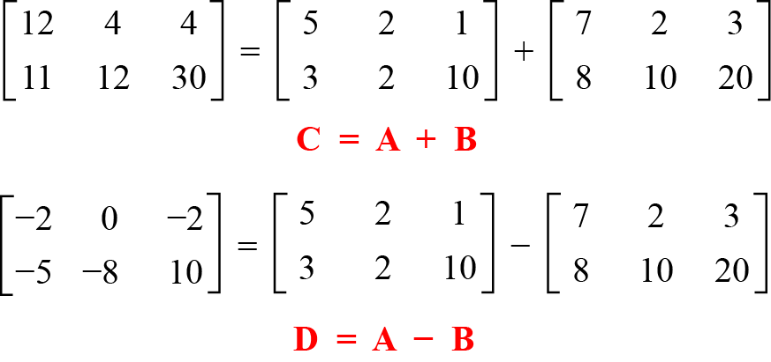
Matrices
Addition and Subtraction:
Two matrices can be added if they have the same number of rows and columns. The resulting matrix has also the same number of rows and columns, e.g. A + B = C.
Example:
Figure: Addition and subtraction of matrices

Slide 79
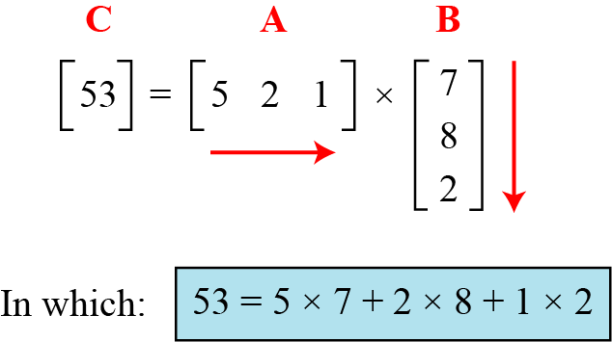
Matrices
Multiplication:
Two matrices can be multiplied if the number of columns of the first matrix is the same as the number of rows of the second matrix.
If A is an l×m matrix and B is an m×p matrix, then their product is a matrix C of size l×p.
Example-1:
Figure shows the product of a row matrix (1 × 3) by a column matrix (3 × 1). The result is a matrix of size 1 × 1.
Figure: Multiplication of a row matrix by a column matrix

Slide 80
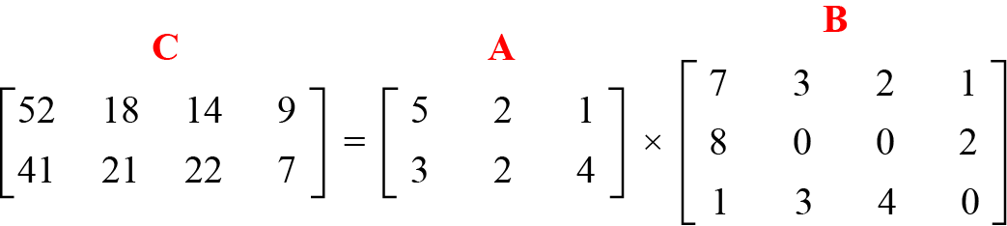
Matrices
Example-2:
Figure shows the product of a 2 × 3 matrix by a 3 × 4 matrix. The result is a 2 × 4 matrix.
Figure: Multiplication of a 2 × 3 matrix by a 3 × 4 matrix

Slide 81
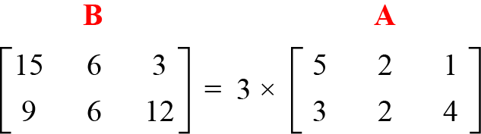
Matrices
Scalar Multiplication:
We can multiply a matrix by a number (called a scalar). If A is an l×m matrix and x is a scalar, then C = xA is a matrix of size l×m.
Example:
Figure below shows an example of scalar multiplication.
Figure: Scalar multiplication

Slide 82
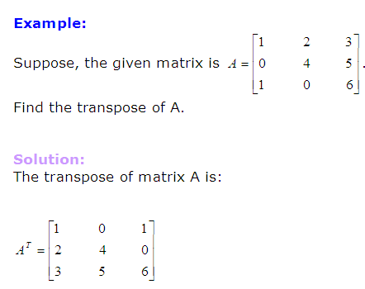
Matrices
Transpose of a Matrix:
A matrix which is formed by turning all the rows of a given matrix into columns and vice-versa is called the transpose of the original matrix. The transpose of matrix A is written A^{T}.

Slide 83
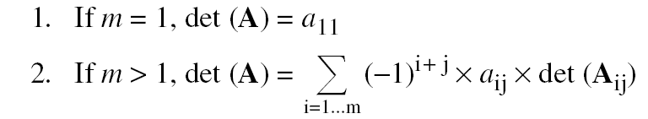
Matrices
Determinant
The determinant of a square matrix A of size m × m denoted as det (A) is a scalar calculated recursively as shown below:
The determinant is defined only for a square matrix.

Slide 84
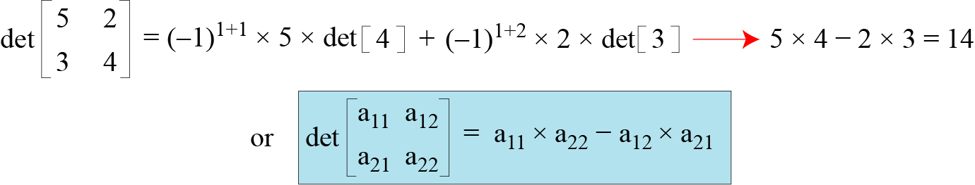
Matrices: Determinant
Example-1:
Figure below shows how we can calculate the determinant of a 2 × 2 matrix based on the determinant of a 1 × 1 matrix.
Figure: Calculating the determinant of a 2 × 2 matrix

Slide 85
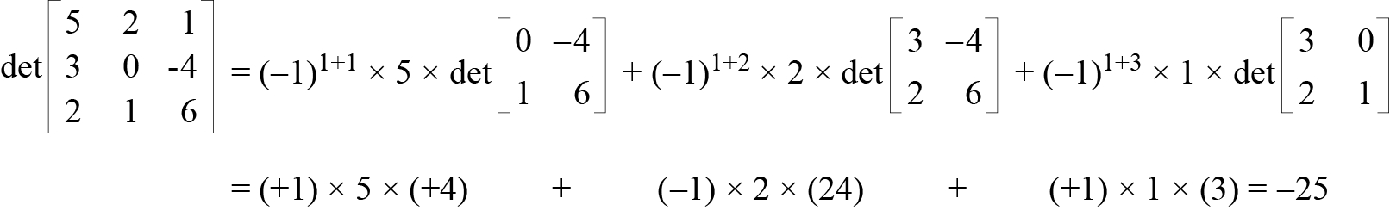
Matrices: Determinant
Example-2:
Figure below shows the calculation of the determinant of a 3 × 3 matrix.
Figure: Calculating the determinant of a 3 × 3 matrix

Slide 86
Matrices: Determinant
Example-3:
Calculate the determinant of the following matrix.

Slide 87
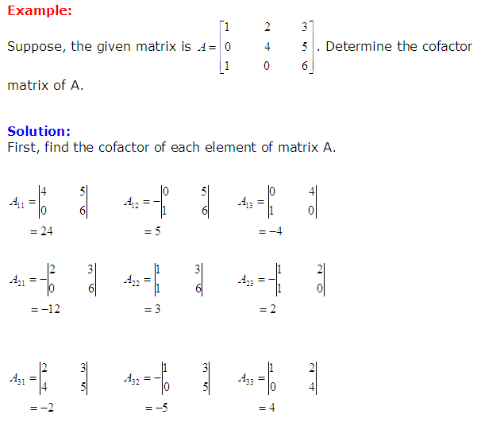
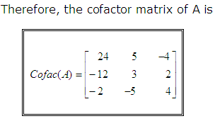
Matrices
Cofactor Matrix of a Given Matrix

Slide 88
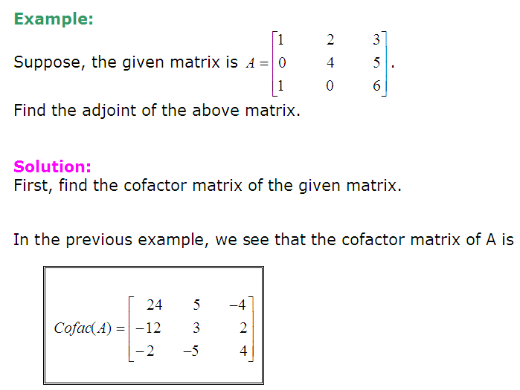
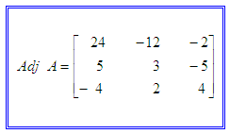
Matrices
Adjoint of a Given Matrix
The matrix formed by taking the transpose of the cofactor matrix of a given original matrix is called the adjoint of the given matrix. The adjoint of matrix A is often written adj A.
Finally the adjoint of A is the transpose of the cofactor matrix:

Slide 89
Matrices
Inverse of Matrix
For an n×n square matrix A, the inverse of A (written as A⁻¹) is another n×n square matrix such that when A is multiplied by A⁻¹ the result is an n×n identity matrix I.
Not all n×n matrices are invertible. Non-square matrices do not have inverses.
AA⁻¹ = A⁻¹A = I
A matrix which is not invertible is sometimes called a singular matrix.
An invertible matrix is called a nonsingular matrix.

Slide 90
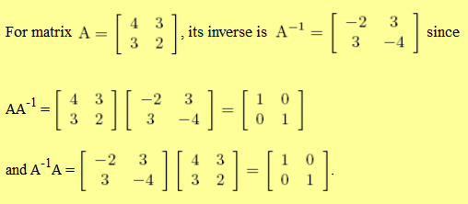
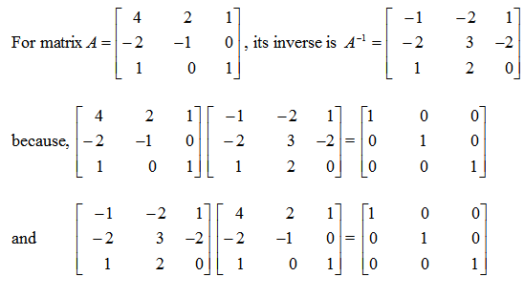
Matrices: Inverse
Examples-1:
Examples-2:

Slide 91

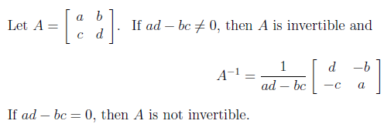
Matrices: Inverse
Determining the Inverse of Matrix
When A is a 2×2 Matrix:
Example-1:

Slide 92
Matrices: Inverse
When A is a 2×2 Matrix:
Example-2:

Slide 93

Matrices: Inverse
When A is an m × m Matrix:
To find the inverse of an m×m matrix, follow the steps given below:
Find the adjoint of the given matrix.
Find the determinant of the given matrix.
Now, determine the inverse using the above formula.

Slide 94
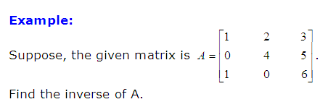
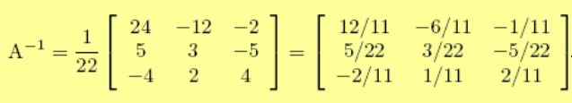
Matrices
Solution:
The adjoint of A is :
The determinant of A is :
The inverse of A is :

Slide 95
Additive & Multiplicative Inverse of Matrix
Matrices have both additive and multiplicative inverses.
Additive Inverse of a Matrix:
The additive inverse of a matrix A is another matrix B such that A + B = 0.
In other words, we have a_{ij} = - b_{ij} for all values of i and j. Normally the additive inverse of A is denoted by –A.
Multiplicative Inverse of a Matrix:
The multiplicative inverse of a square matrix A is another square matrix B such that A × B = B × A = I. Normally the multiplicative inverse of A is denoted by A⁻¹.
The multiplicative inverse is only defined for square matrices and exists only if the det(A) has a multiplicative inverse in the corresponding set.

Slide 96
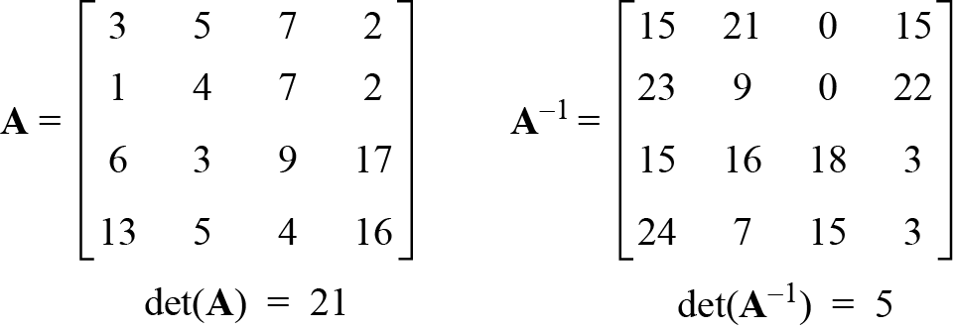
Residue Matrices
Residue matrix is a kind of square matrix in which all elements are in Z_{n}.
Cryptography uses residue matrices.
A residue matrix has a multiplicative inverse if gcd (det(A), n) = 1.
Example:
Figure: A residue matrix and its multiplicative inverse

Slide 97
Prime Number
Prime number is a type of positive integers in which each integers has exactly two divisors 1 and itself.
2 is the smallest prime which has two divisors only, 1 and 2.
Asymmetric-key cryptography uses primes extensively.
Any composite number can be uniquely expresses as a product of prime, where the prime factors are written in order of increasing size. Example: 26 = 2 × 13; 100 = 2 × 2 × 5 × 5 = 2² × 5².
Example:
List the primes smaller than 10.
Solution
There are four primes less than 10. These are 2, 3, 5, and 7.
It is interesting to note that the percentage of primes in the range 1 to 10 is 40%. The percentage decreases as the range increases.

Slide 98
Cardinality of Primes
There is an infinite number of primes.
Number of Primes ϖ(n):
Example-1
As a trivial example, assume that the only primes are in the set {2, 3, 5, 7, 11, 13, 17}. Here P = 510510 and P + 1 = 510511. However, 510511 = 19 × 97 × 277; none of these primes were in the original list. Therefore, there are three primes greater than 17.
Example-2
Find the number of primes less than 1,000,000.
Solution
The approximation gives the range 72,383 to 78,543. The actual number of primes is 78,498.

Slide 99
Checking for Primeness (Primality Testing)
Given a number n, how can we determine if n is a prime?
The answer is that we need to see if the number is divisible by all primes less than √n.
We know that this method is inefficient, but it is a good start.
Example-1:
Is 97 a prime?
Solution:
The floor of √97 = 9.
The primes less than 9 are 2, 3, 5, and 7.
We need to see if 97 is divisible by any of these numbers. It is not, so 97 is a prime.
Example-2:
Is 301 a prime?
Solution:
The floor of √301= 17.
The primes less than 17 are 2, 3, 5, and 7.
We need to see if 301 is divisible by any of these numbers. Since 7 | 301, so 301 is not a prime.

Slide 100
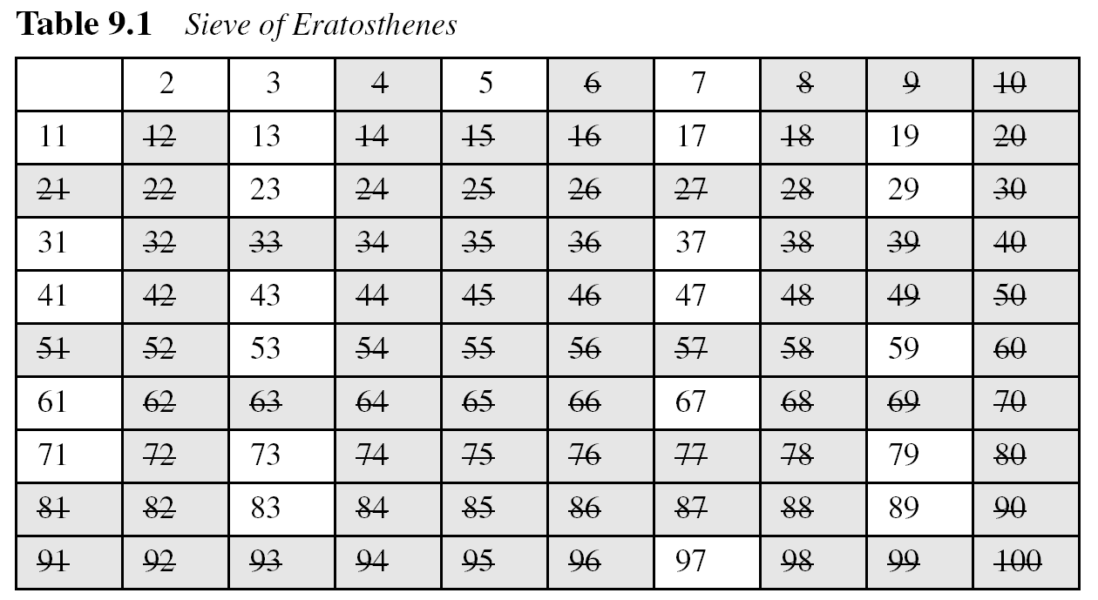
Checking for Primeness (Primality Testing)
Sieve of Eratosthenes:

Slide 101
Chinese Remainder Theorem
The Chinese remainder theorem (CRT) is used to solve a set of congruent equations with one variable but different moduli, which are relatively prime, as shown
below:

Slide 102
Chinese Remainder Theorem
Example:
The following is an example of a set of equations with different moduli:
The solution to this set of equations is given in the next section; for the moment, note that the answer to this set of equations is x = 23. This value satisfies all equations: 23 ≡ 2 (mod 3), 23 ≡ 3 (mod 5), and 23 ≡ 2 (mod 7).

Slide 103
Chinese Remainder Theorem
Solution to Chinese Remainder Theorem:
Find M = m₁ × m₂ × … × m_{k}. This is the common modulus.
Find M₁ = M/m₁, M₂ = M/m₂, …, M_{k} = M/m_{k}.
Find the multiplicative inverse of M₁, M₂, …, M_{k} using the corresponding moduli (m₁, m₂, …, m_{k}). Call the inverses M₁⁻¹, M₂⁻¹, …, M_{k} ⁻¹.
The solution to the simultaneous equations is

Slide 104
Chinese Remainder Theorem
Example-1:
Find the solution to the simultaneous equations:
Solution: We follow the four steps.
M = 3 × 5 × 7 = 105
M₁ = 105 / 3 = 35, M₂ = 105 / 5 = 21, M₃ = 105 / 7 = 15
The inverses are M₁⁻¹ = 2, M₂⁻¹ = 1, M₃ ⁻¹ = 1
x = (2 × 35 × 2 + 3 × 21 × 1 + 2 × 15 × 1) mod 105 = 23 mod 105

Slide 105
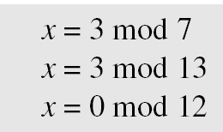
Chinese Remainder Theorem
Example-2:
Find an integer that has a remainder of 3 when divided by 7 and 13, but is divisible by 12.
Solution:
This is a CRT problem. We can form three equations and solve them to find the value of x.
If we follow the four steps, we find x = 276. We can check that 276 = 3 mod 7, 276 = 3 mod 13 and 276 is divisible by 12 (the quotient is 23 and the remainder is zero).

Slide 106
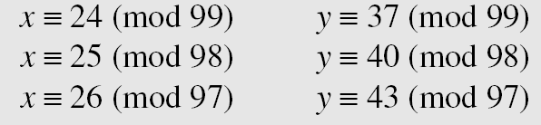
Chinese Remainder Theorem
Example-3:
Assume we need to calculate z = x + y where x = 123 and y = 334, but our system accepts only numbers less than 100. These numbers can be represented as follows:
Adding each congruence in x with the corresponding congruence in y gives
Now three equations can be solved using the Chinese remainder theorem to find z. One of the acceptable answers is z = 457.

Slide 107
Discussion Points
Importance of Math in Network Security
Integer Arithmetic with Binary Operations
Divisibility and Modular Arithmetic
Greatest Common Divisors
Determining Multiplicative Inverse
Solving Linear Diophantine Equations
Matrices
Prime Factorization

Slide 108

Have a question?
Thank you…

